Slide 1
THE 5 RULES
OF
LAB SAFETY

Slide 2
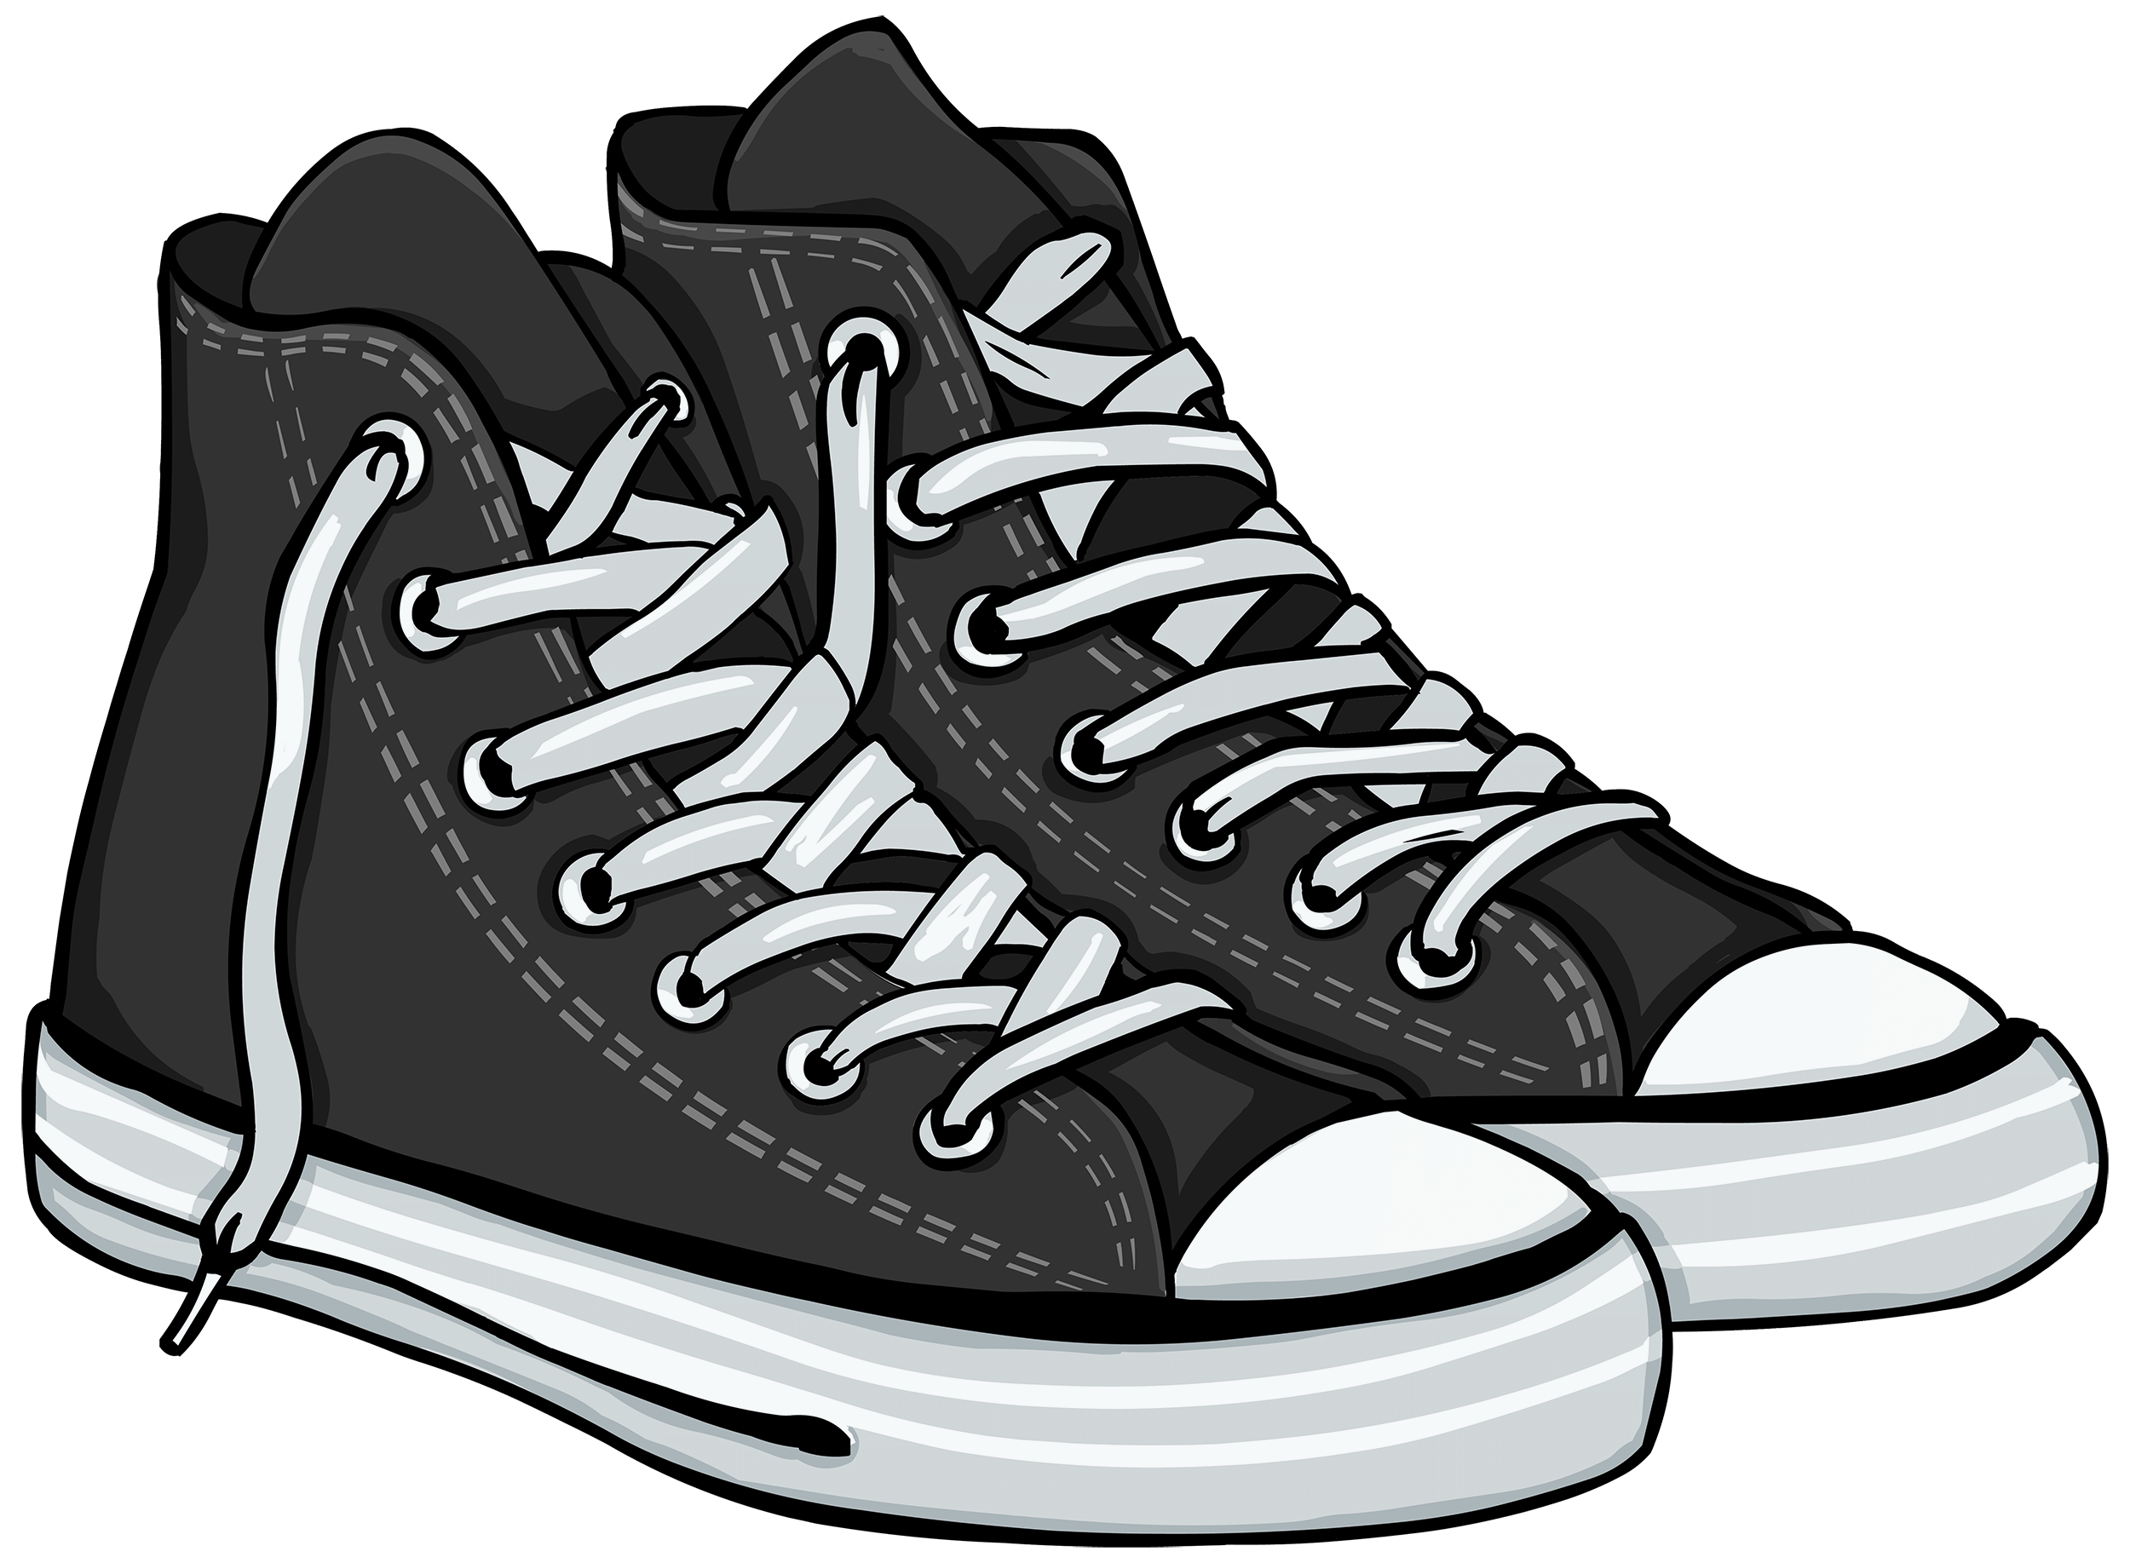
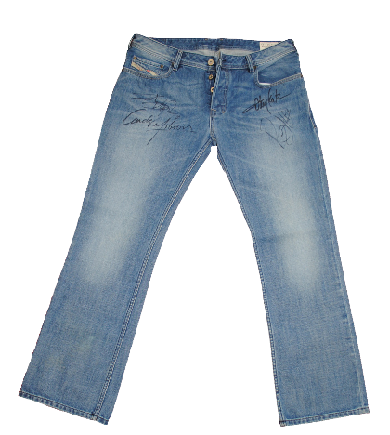
Rule #1: Dress for Lab
✔️ Do wear…
Closed-toe shoes
Long pants
--------------------------------------------------
✖️ Don’t wear…
Jewelry
Lose hair

Slide 3
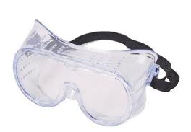
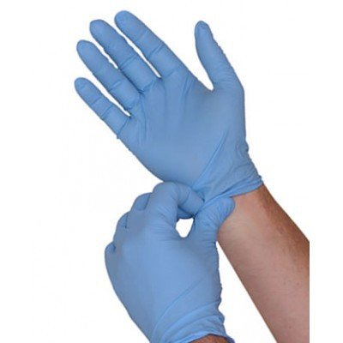
Rule #2: Personal Protective Equipment
✔️ For general lab work always wear…
Safety goggles
Gloves
Apron (or lab coat)

Slide 4
Rule #3: Chemical Safety
Each chemical in the lab must have a Safety Data Sheet (SDS) that describes its properties and potential hazards including:
Storage & handling
Expiration date
Fire hazard
First aid

Slide 5
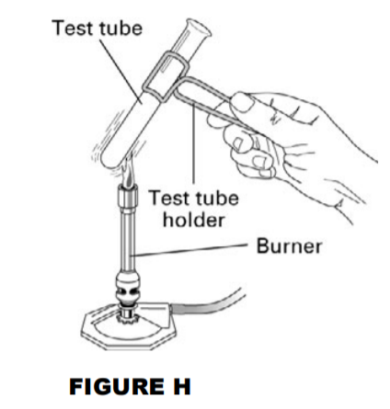
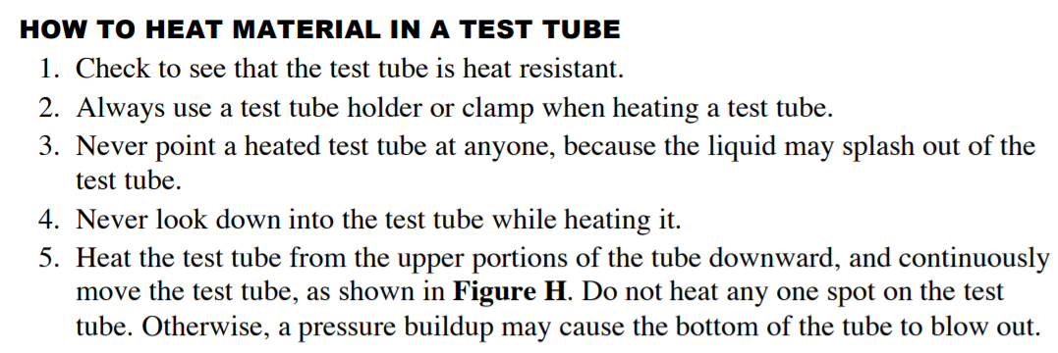
Rule #3: Chemical Safety Techniques

Slide 6
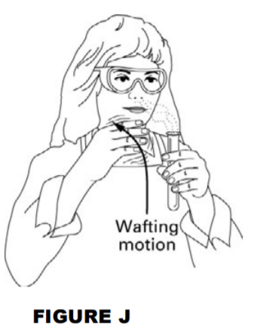
Rule #3: Chemical Safety Techniques Continued…
Wafting Motion: used to smell odors safely

Slide 7
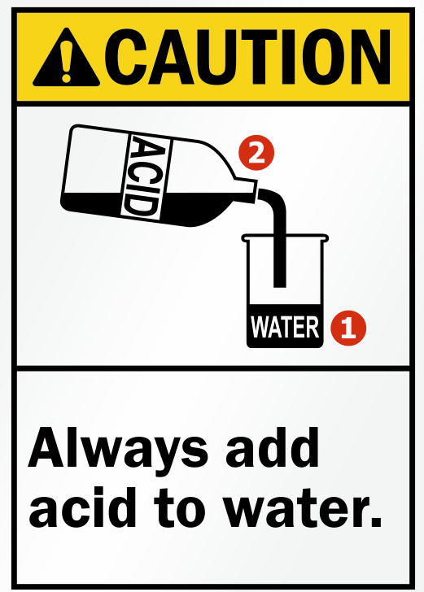
Rule #3: Chemical Safety Techniques Continued…
✖️
✔️
✖️
✔️
This is what happens if water is added into a concentrated acid to dilute it. So, never pour water into an acid.

Slide 8
Rule #4: Safety Equipment
✔️ Always know the location of your safety equipment…
Safety shower
Eye wash station
Fire blanket
First aid kit
Fire extinguisher

Slide 9
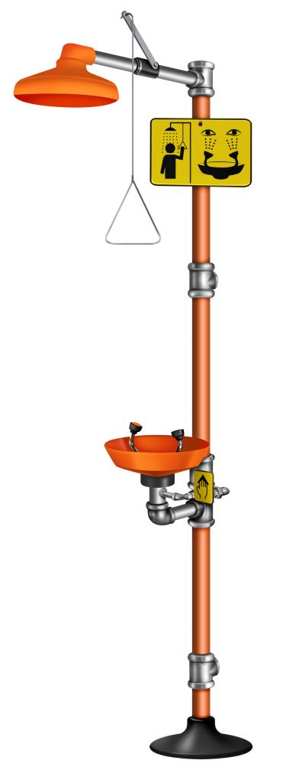
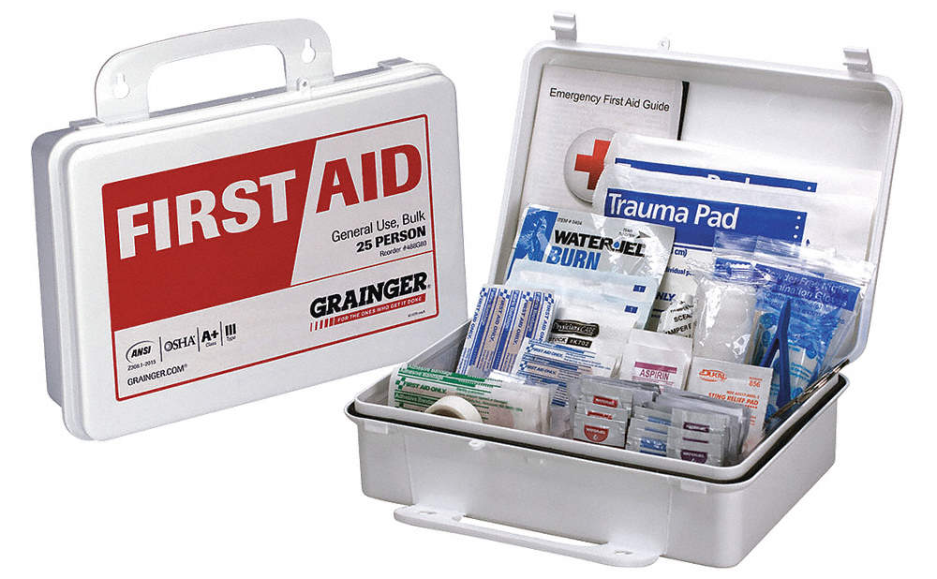
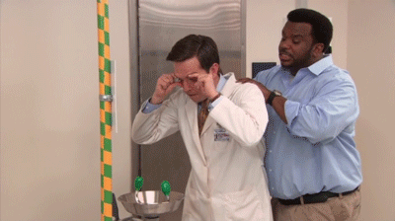
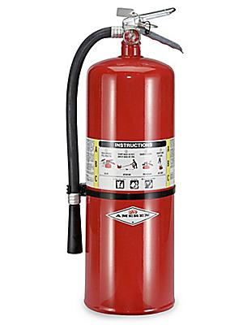

Slide 10
Rule #5: Lab Behavior
This rule may be the most important because it is all about LAB BEHAVIOR:
NO food or drink in the lab. ✖️
Practice good housekeeping. ✔️
NEVER work alone. ✖️

